Slide 1
CS4430- FINAL PROJECT REPORT ONLINE TRANSCRIPT SYSTEM
Aashray Shrestha
Note : I have inserted many GIF’s and it will only work when you use the slideshow.

Slide 2
The idea behind this project was to develop a project with the use of Database and to include it in as many ways as possible. Since the project is a transcript system the main features of the project are : 1. Add : Students/Classes/Grades 2. Manage : Students/ Classes/ Grades 3. Modify : Students/ Classes/ Grades 4. View Final Results : Individual + All Students Furthermore, the use of login technology has been used in this project so that the same session will continue until the admin logs out of the active session. There are two interfaces server side and client side
Project Summary

Slide 3

Languages Used
HTML
CSS
JAVASCRIPT
PHP
MySQL

Slide 4
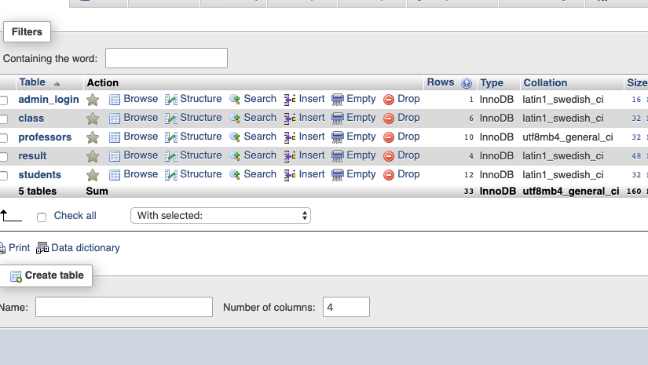
DATABASE STRUCTURE

Slide 5
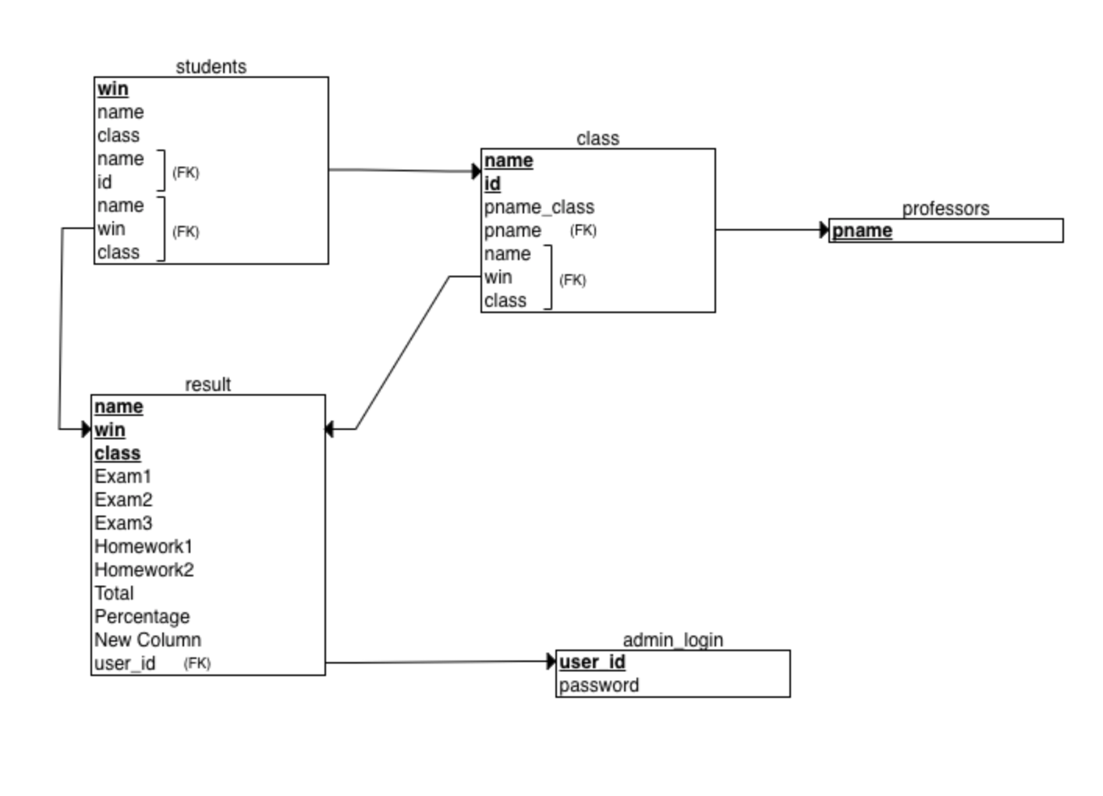
Relational Model
Created using https://erdplus.com/standalone

Slide 6
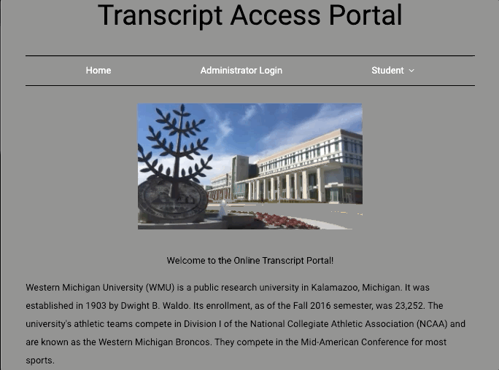
Transcript Access Portal
This is the index page of the transcript access portal. Rather than having a direct login, providing a little bit of a background to the users about the portal and its use has been noted in the landing page. The next thing is the navigation bar which consists of the various links that you can visit.

Slide 7
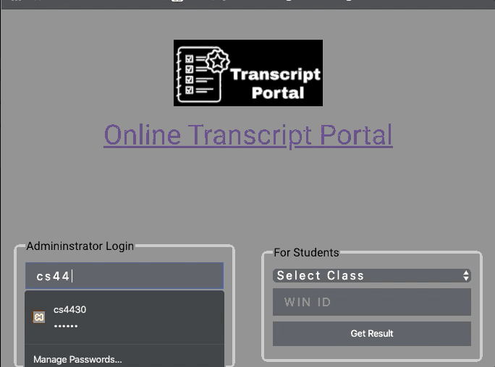
LOGIN PAGE
The login page consists of two login sections : server and client.
Administrator Login is secured with a userid & password. Students can only access their grades for the classes by choosing the list of classes from the dropdown button and entering their WIN ID.
Note : admin login & password : ”cs4430” , “cs4430”

Slide 8
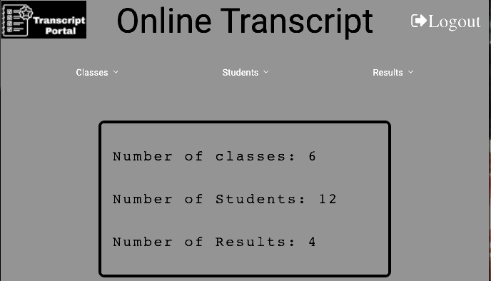
Dashboard Page
After administrator login, you will be directed to the dashboard page which has links to various other pages to add, view, and manage students, classes and results.
The dashboard also has a container which uses the count() method to display the number of classes, students, and results

Slide 9
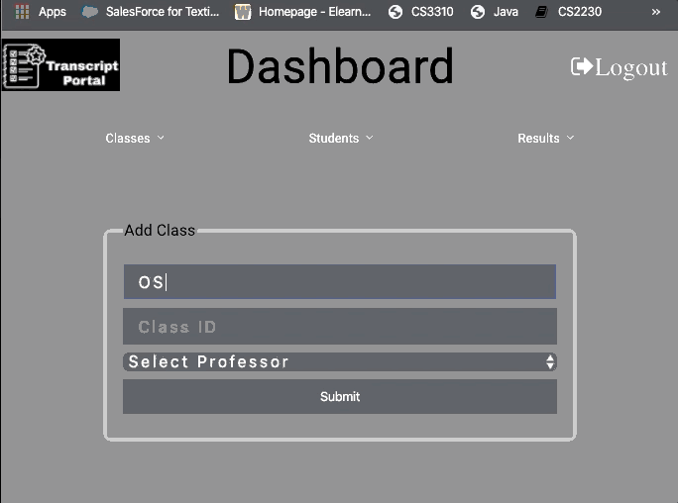
Add Class
The add class function will add a certain class to the database.
However, it will not add classes with the same class id and will report an error when the class id clashes with another class. The select professor is a dynamic setting from the database that lists name of all professors from the database that you can select from

Slide 10
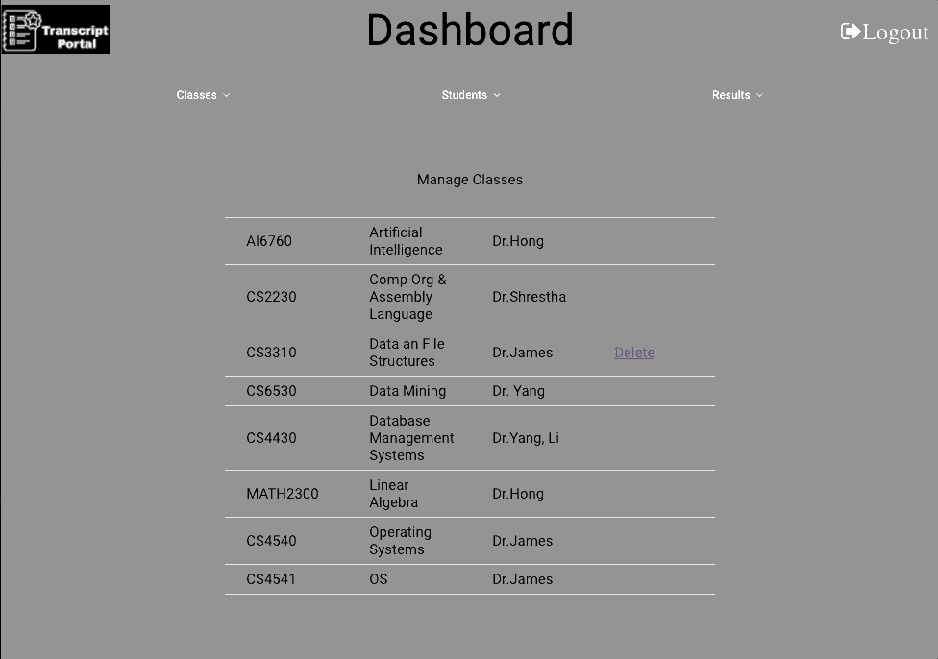
Manage Class
The manage class lists the Classes in order of entry with the class code and instructor. It also has options to delete the classes from the list. Error Handling : Since the data entered in classes are used later to add students and create results, classes with students enrolled can not be deleted, and an appropriate message pops up when you try to delete a class with students enrolled.

Slide 11
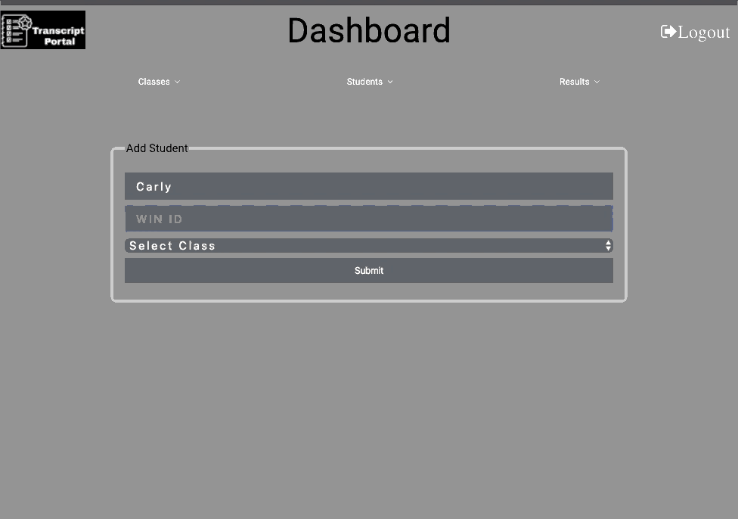
Add Students
The add student function will add a certain student to the database.
However, it will not add students with the same WIN ID and will report an error when the WIN ID clashes with another student’s information. The select class is a dynamic setting from the database that lists name of all class from the database that you can select from. This will change according to the entry in the class table.

Slide 12
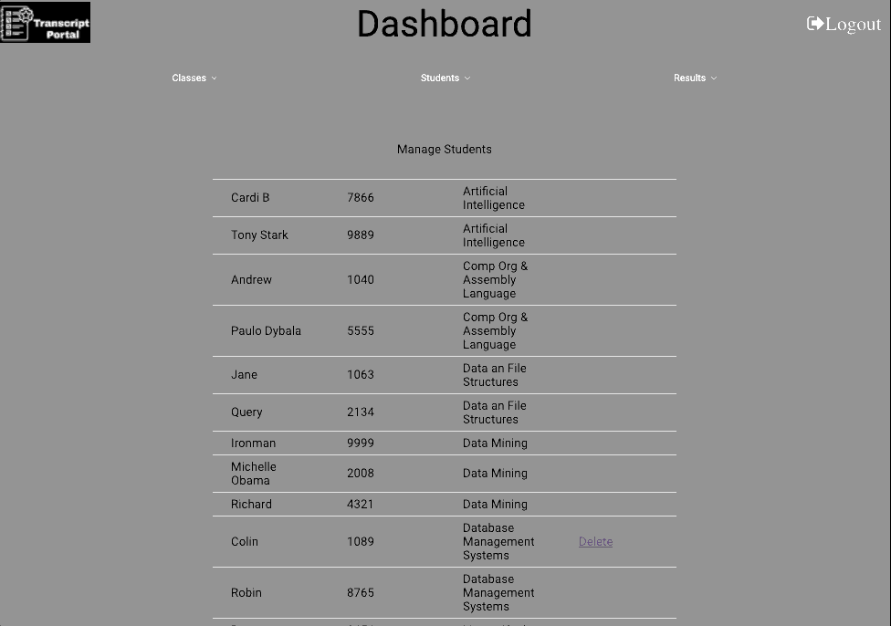
Manage Students
The manage student lists the students in order of entry with the class code and instructor. It also has options to delete the classes from the list. Error Handling : Since the data entered in students are used later to create results, students that already have results posted can not be deleted, and an appropriate message pops up when you try to delete a student with posted results.

Slide 13
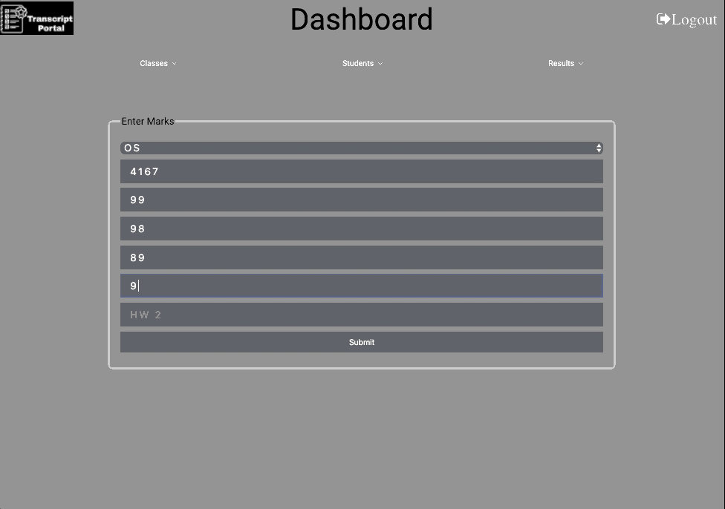
Add Results
The add results function will add a certain result for the student with the entered WIN ID and class to the database.
However, it will not add results for students that already have a result posted for them. The select class is a dynamic setting from the database that lists name of all class from the database that you can select from. This will change according to the entry in the class table. There are 5 options to post scores and it will not accept a null value.

Slide 14
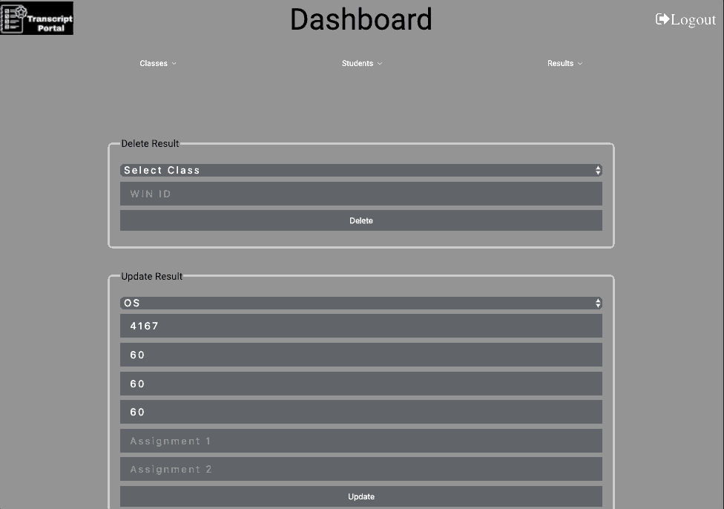
Manage Results
The manage results has options to update a result for a student or to delete the result from the list. Error Handling : Results can only be deleted for those with available results and it will show appropriate message when you try to push null values or enter a wrong WIN ID and Class combination.

Slide 15
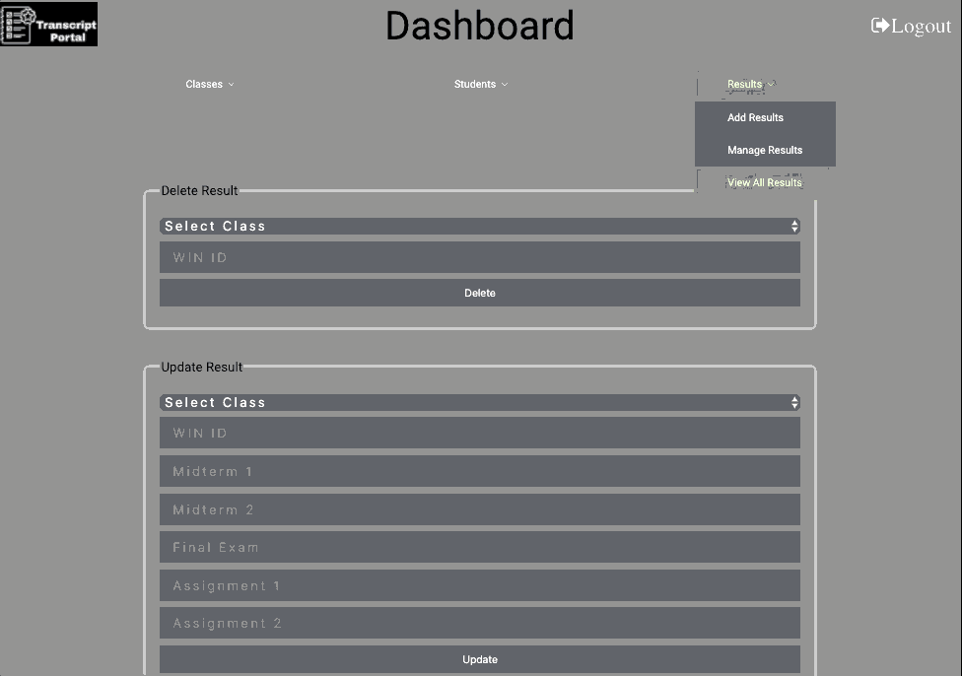
View All Results
The view all results will view all the results for the students in order and will show the Name, WIN ID, Class and Grade in that class.
This is a very simple class to show the updated results made during the previous steps mentioned in the presentation.

Slide 16
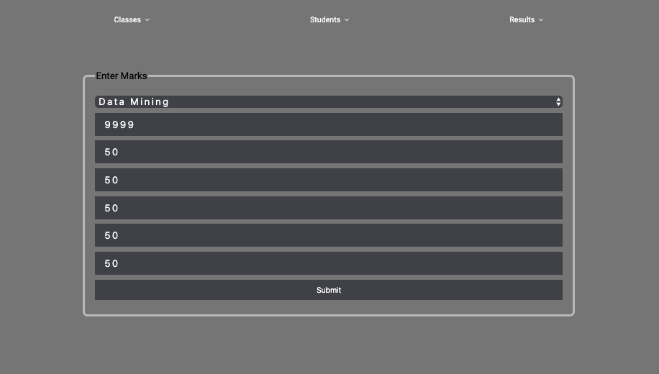
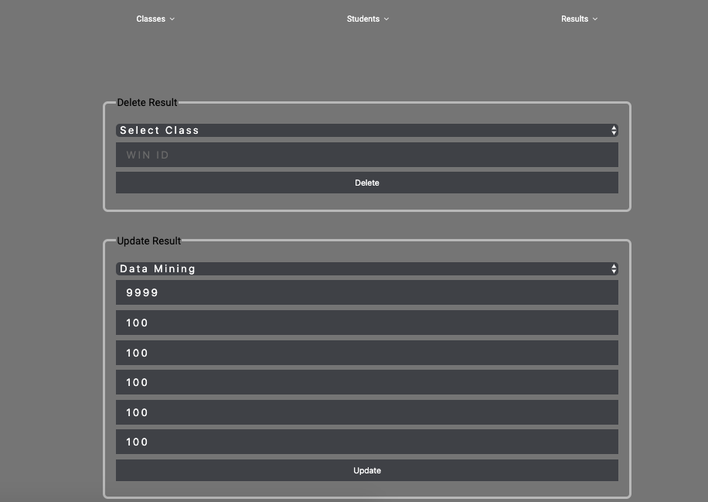
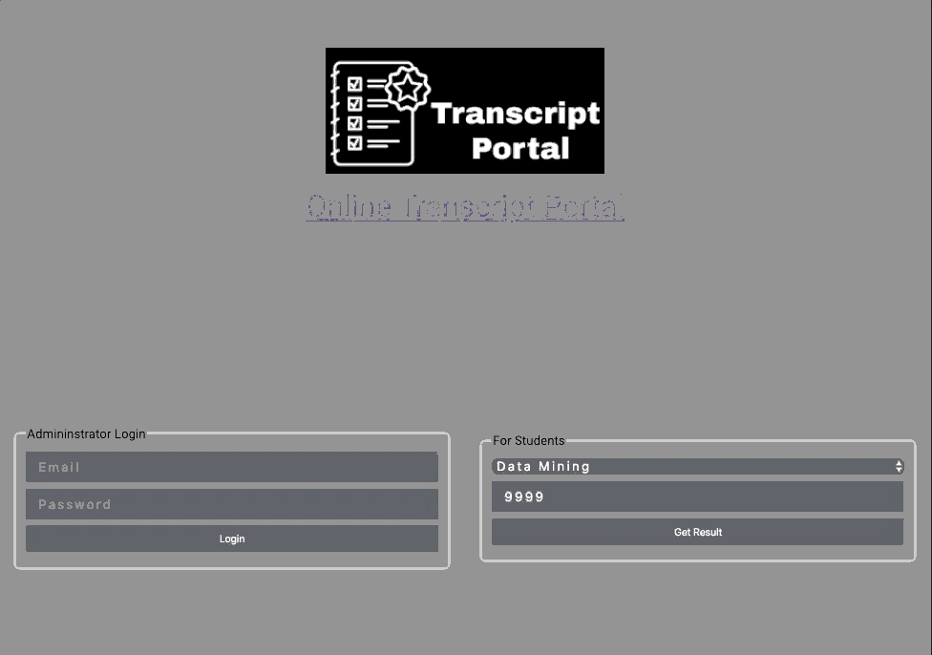
Results Added Modified View
Adding a new student to the Data Mining Class With Scores that average : 50 points
Modifying the results to have the new scores to have an average : 100 points
When viewing the transcript, after the modification: the result shows : 100 points

Slide 17
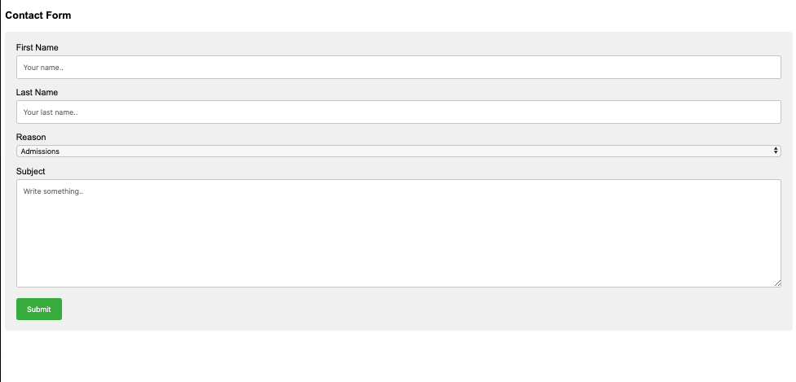
Contact Form

Slide 18
Challenges
Forming a model for the database
The session that will stay from one page to another and not logout unless prompted
Figuring out the relations between the Students – Classes – Results and error handling to not delete certain data if the foreign key is required somewhere else
Create a connection between the add class/ add student / and view, modify results

Slide 19
Acknowledgement
Database Management and the use of SQL Queries was made so much easier for me to understand when actually doing the project because I understood the relation and what had to be done. The project also made me learn about creating connections in php and more about web technologies. This project was an eye opener for me as I want to work in the field of web technologies and the use of backend technologies is very important and plays as much, if not more, role in creating the best User Interface.

Slide 20
Sources
Connection https://stackoverflow.com/questions/20407699/php-connect-to-mysql-database
W3 Schools https://www.w3schools.com/
PHP and MySQL for Dynamic Websites Ullman, Larry E. PHP and MySQL for Dynamic Web Sites. Peachpit Press, 2012.
ProjectWorlds : PHP https://projectworlds.in/my-account/

